Slide 1
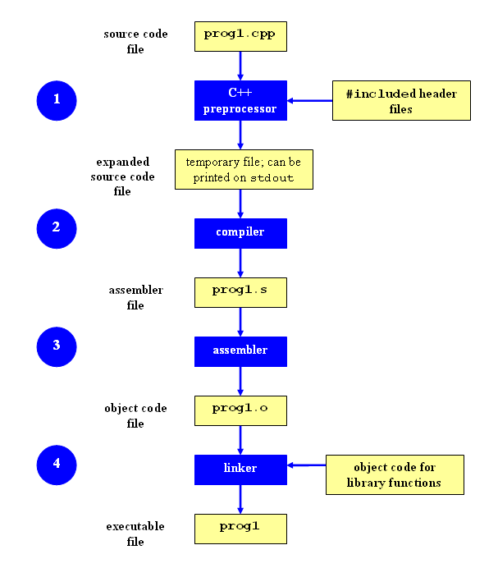
Makefile

Slide 2
Makefile
Separate Compilation
What does the compiler do when it sees #include of a .h file in a .c file?
When you have many .c files, you will end up creating a corresponding .o file. In UNIX C compilers this is done with the -c option.
Makefiles
not necessary to recompile all the files when you make changes
only need to recompile a small subset of the files

Slide 3
Makefile
Each entry has:
<target>: [ <dependencies> ]
[ <TAB> <command> <endl> ]
<target> is a name for the action executed by the rule or (usually) a file name
clean, install, .o file
<dependencies> files which the target depends on
<command> to run

Slide 4
Makefile
The entry tells how to construct a target, and more importantly, when to construct the target

Slide 5
Makefile
all: vector
vector: main.o vector.o
gcc -Wall -pedantic main.o vector.o -o vector
main.o: main.c vector.h
gcc -c main.c
vector.o: vector.c vector.h status.h
gcc -Wall -pedantic -c vector.c
clean:
rm -rf *.o *~ vector
Notes:
Usually, the purpose of the Makefile is to create an executable. That target is often the first target in the Makefile
all is a special target that depends on main.o and vector.o, and has the command (from the “manual” steps earlier) to make GCC link the two object files into the final executable binary.
-o option to create an executable with a name other than a.out.
-g debug info
GCC compilers always try to compile your program if this is at all possible. However, in some cases, the C and C++ standards specify that certain extensions are forbidden. Conforming compilers such as gcc or g++ must issue a diagnostic when these extensions are encountered. For example, the gcc compiler’s -pedantic option causes gcc to issue warnings in such cases. Using the stricter -pedantic-errors option converts such diagnostic warnings into errors that will cause compilation to fail at such points. Only those non-ISO constructs that are required to be flagged by a conforming compiler will generate warnings or errors.

Slide 6
Makefile: Implicit Rules
Default makefile variables: by changing the values of the variables, it is possible to change the way the implicit rule works
CPPFLAGS: the parameters to be passed to the C preprocessor (for example, -I <path>, -D <symbol>)
CFLAGS: the parameters to be passed to the C compiler (for example, -Wall, -g, etc)
CXXFLAGS: the parameters to be passed to the C++ compiler
LDFLAGS: the parameters to be passed to the linker (for example, -L<path>, etc)
LDLIBS: the libraries that have to be linked into the executable (for example, -lm, etc)
Notes:
To avoid the need to repeat similar rules in all the makefiles, GNU Make pro-
vides some implicit rules, which automatically implement standard techniques
for building some targets. For example, there are implicit rules for building
executables files from object files, or to compile .c source files into .o objects.
Implicit rules use some default makefile variables so that, by changing the
values of the variables, it is possible to change the way the implicit rule works.

Slide 7
Makefile
Macro definitions
Macros are usually put at the beginning of a Makefile.
A macro has the following syntax:
<macro_name> = <macro_string>
Notes:
We can assign values (RHS) to variables (LHS) with this operator, for example: CC := gcc. With simple assignment (:=), the value is expanded and stored to all occurrences in the Makefile when its first definition is found.
For example, when a CC := ${GCC} ${FLAGS} simple definition is first encountered, CC is set to gcc -W and wherever ${CC} occurs in actions, it is replaced with gcc -W.
Using patterns and special variables
The % character can be used for wildcard pattern-matching, to provide generic targets. For example:
%.o: %.c
[TAB] actions
When % appears in the dependency list, it is replaced with the same string that was used to perform substitution in the target.
Inside actions, we can use special variables for matching filenames. Some of them are:
$@ (full target name of the current target)
$? (returns the dependencies that are newer than the current target)
$* (returns the text that corresponds to % in the target)
$< (name of the first dependency)
$^ (name of all the dependencies with space as the delimiter)
Instead of writing each of the file names in the actions and the target, we can use shorthand notations based on the above, to write more generic Makefiles.
Use PHONY to avoid file-target name conflicts
Remember the all and clean special targets in our Makefile? What happens when the project directory has files with the names all or clean? The conflicts will cause errors. Use the .PHONY directive to specify which targets are not to be treated as files — for example: .PHONY: all clean.

Slide 8
Makefile
make clean
clean:
\rm *.o *~ p1
The backslash prevents "rm" from complaining
Normally, you remove all .o files, all files ending in ~ (which are emacs backup files), and the name of the executable

Slide 9
Makefile
http://www.gnu.org/software/make/manual/make.html#Simple-Makefile
http://opensourceforu.com/2012/06/gnu-make-in-detail-for-beginners/

